Slide 1
Hibernate

Slide 2
Introduction
Hibernate ORM (Hibernate in short) is an object-relational mapping tool for the Java programming language.
It provides a framework for mapping an object-oriented domain model to a relational database.
Hibernate solves object-relational impedance mismatch problems by replacing direct, persistent database accesses with high-level object handling functions.

Slide 3
Why Object Relational Mapping (ORM)?
When we work with an object-oriented systems, there's a mismatch between the object model and the relational database.
RDBMSs represent data in a tabular format whereas object-oriented languages, such as Java or C# represent it as an interconnected graph of objects.
Mismatch | Description
Granularity | Sometimes you will have an object model which has more classes than the number of corresponding tables in the database.
Inheritance | RDBMSs do not define anything similar to Inheritance which is a natural paradigm in object-oriented programming languages.(Not Supported by RDBMS but by OOPS)
Identity | A RDBMS defines exactly one notion of 'sameness': the primary key. Java, however, defines both object identity (a==b) and object equality (a.equals(b)).
Associations | Object-oriented languages represent associations using object references where as am RDBMS represents an association as a foreign key column.
Navigation | The ways you access objects in Java and in a RDBMS are fundamentally different.

Slide 4
What is ORM?
ORM stands for Object-Relational Mapping (ORM) is a programming technique for converting data between relational databases and object oriented programming languages such as Java, C# etc.
Advantages
Lets business code access objects rather than DB tables.
Hides details of SQL queries from OO logic.
Based on JDBC 'under the hood‘
No need to deal with the database implementation..
Entities based on business concepts rather than database structure.
Transaction management and automatic key generation.
Fast development of application.

Slide 5
An ORM solution consists of the following four entities:
S.N. | Solutions
1 | An API to perform basic CRUD operations on objects of persistent classes.
2 | A language or API to specify queries that refer to classes and properties of classes.
3 | A configurable facility for specifying mapping metadata.
4 | A technique to interact with transactional objects to perform dirty checking, lazy association fetching, and other optimization functions.

Slide 6
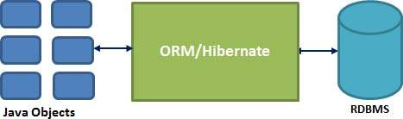
Hibernate - Overview
Hibernate is an Object-Relational Mapping(ORM) solution for JAVA and it raised as an open source persistent framework created by Gavin King in 2001.
It is a powerful, high performance Object-Relational Persistence and Query service for any Java Application.
Hibernate maps Java classes to database tables and from Java data types to SQL data types and relieve the developer from 95% of common data persistence related programming tasks.
Hibernate sits between traditional Java objects and database server to handle all the work in persisting those objects based on the appropriate O/R mechanisms and patterns.

Slide 7
Hibernate Advantages:
Hibernate takes care of mapping Java classes to database tables using XML files and without writing any line of code.
Provides simple APIs for storing and retrieving Java objects directly to and from the database.
If there is change in Database or in any table then the only need to change XML file properties.
Abstract away the unfamiliar SQL types and provide us to work around familiar Java Objects.
Hibernate does not require an application server to operate.
Manipulates Complex associations of objects of your database.
Minimize database access with smart fetching strategies.
Provides Simple querying of data.

Slide 8
Supported Databases:
Hibernate supports almost all the major RDBMS.
Following is list of few of the database engines supported by Hibernate.
HSQL Database Engine
DB2/NT
MySQL
PostgreSQL
FrontBase
Oracle
Microsoft SQL Server Database
Sybase SQL Server
Informix Dynamic Server

Slide 9
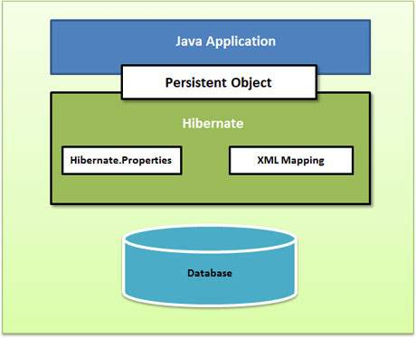
Hibernate - Architecture
The Hibernate architecture is layered to keep you isolated from having to know the underlying APIs.
Hibernate makes use of the database
and configuration data to provide
persistence services
(and persistent objects) to the
application.

Slide 10
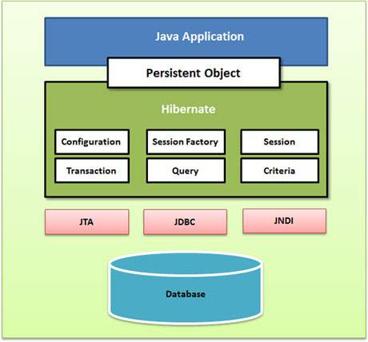
Backend API

Slide 11
Configuration Object:
The Configuration object is the first Hibernate object you create in any Hibernate application and usually created only once during application initialization.
It represents a configuration or properties file required by the Hibernate.
The Configuration object provides two keys components:
Database Connection: This is handled through one or more configuration files supported by Hibernate.
These files are hibernate.properties and hibernate.cfg.xml.
Class Mapping Setup : This component creates the connection between the Java classes and database tables.

Slide 12
SessionFactory Object:
Configuration object is used to create a SessionFactory object which in-turn configures Hibernate for the application using the supplied configuration file and allows for a Session object to be instantiated.
The SessionFactory is a thread safe object and used by all the threads of an application.
The SessionFactory is heavyweight object so usually it is created during application start up and kept for later use.
You would need one SessionFactory object per database using a separate configuration file.
So if you are using multiple databases then you would have to create multiple SessionFactory objects.

Slide 13
Session Object:
A Session is used to get a physical connection with a database.
The Session object is lightweight and designed to be instantiated each time an interaction is needed with the database.
Persistent objects are saved and retrieved through a Session object.
The session objects should not be kept open for a long time because they are not usually thread safe and they should be created and destroyed them as needed.

Slide 14
Transaction Object:
A Transaction represents a unit of work with the database and most of the RDBMS supports transaction functionality.
Transactions in Hibernate are handled by an underlying transaction manager and transaction (from JDBC or JTA)
This is an optional object and Hibernate applications may choose not to use this interface, instead managing transactions in their own application code.

Slide 15
Query Object:
Query objects use SQL or Hibernate Query Language (HQL) string to retrieve data from the database and create objects.
A Query instance is used to bind query parameters, limit the number of results returned by the query, and finally to execute the query.
Criteria Object:
Criteria object are used to create and execute object oriented criteria queries to retrieve objects.

Slide 16
Hibernate - Mapping Types
When you prepare a Hibernate mapping document, we have seen that you map Java data types into RDBMS data types.
The types declared and used in the mapping files are not Java data types; they are not SQL database types either.
These types are called Hibernate mapping types, which can translate from Java to SQL data types and vice versa.
List of Mapping Types :-
Mapping Types

Slide 17
Hibernate - O/R Mappings
Three most important mapping are followed by the Hibernate for O/R.
These are the mapping of collections, the mapping of associations between entity classes and Component Mappings.

Slide 18
Collections Mappings:
If an entity or class has collection of values for a particular variable, then we can map those values using any one of the collection interfaces available in java.
Hibernate can persist requests of java.util.Map, java.util.Set, java.util.SortedMap, java.util.SortedSet, java.util.List, and any array of persistent entities or values.

Slide 19
Collection type | Mapping and Description
java.util.Set | This is mapped with a <set> element and initialized with java.util.HashSet
java.util.SortedSet | This is mapped with a <set> element and initialized with java.util.TreeSet. The sort attribute can be set the element in natural ordering.
java.util.List | This is mapped with a <list> element and initialized with java.util.ArrayList
java.util.Collection | This is mapped with a <bag> or <ibag> element and initialized with java.util.ArrayList
java.util.Map | This is mapped with a <map> element and initialized with java.util.HashMap
java.util.SortedMap | This is mapped with a <map> element and initialized with java.util.TreeMap. The sort attribute can be set the element in natural ordering.

Slide 20
Association Mappings:
The mapping of associations between entity classes and the relationships between tables is the soul of ORM.
Following are the four ways in which the cardinality of the relationship between the objects can be expressed.
An association mapping can be unidirectional as well as bidirectional.
Mapping type | Description
Many-to-One | Mapping many-to-one relationship using Hibernate
One-to-One | Mapping one-to-one relationship using Hibernate
One-to-Many | Mapping one-to-many relationship using Hibernate
Many-to-Many | Mapping many-to-many relationship using Hibernate

Slide 21
Component Mappings:
It is very much possible that an Entity class can have a reference to another class as a member variable.
If the referred class does not have it's own life cycle and completely depends on the life cycle of the owning entity class, then the referred class hence therefore is called as the Component class.
The mapping of Collection of Components is also possible in a similar way just as the mapping of regular Collections with minor configuration differences.
Mapping type | Description
Component Mappings | Mapping for a class having a reference to another class as a member variable.

Slide 22
Hibernate - Annotations
Hibernate annotations is the newest way to define mappings without a use of XML file.
You can use annotations in addition to or as a replacement of XML mapping metadata.
Hibernate Annotations is the powerful way to provide the metadata for the Object and Relational Table mapping.
All the metadata is clubbed into the POJO(Plain old Java Object) java file along with the code this helps the user to understand the table structure and POJO simultaneously during the development.

Slide 23
@Entity Annotation:
Is to mark the current class as an Entity bean Class to manage its persistence.
@Table Annotation:
allows you to specify the details of the table that will be used to persist the entity in the database.
@Id Annotations:
Annotate a class with the primary key of the entity bean.
@GenerateValue Annotations
To generate the value for the primary key of entity bean.
@Column Annotations:
Specify the detail of mapped column.
This annotation has four commonly used attribute.
Name
Length
Nullable
Unique
.

Slide 24
Hibernate - Query Language
Hibernate Query Language (HQL) is an object-oriented query language, similar to SQL, but instead of operating on tables and columns, HQL works with persistent objects and their properties.
HQL queries are translated by Hibernate into conventional SQL queries which in turns perform action on database.
Keywords like SELECT , FROM and WHERE etc. are not case sensitive but properties like table and column names are case sensitive in HQL.
Advantage of HQL
database independent
supports polymorphic queries
easy to learn for Java Programmer

Slide 25
Query Interface
It is an object oriented representation of Hibernate Query.
The object of Query can be obtained by calling the createQuery() method Session interface.
Method | Description
public int executeUpdate() | is used to execute the update or delete query.
public List list() | returns the result of the relation as a list.
public Query setFirstResult(int rowno) | specifies the row number from where record will be retrieved.
public Query setMaxResult(int rowno) | specifies the no. of records to be retrieved from the relation (table).
public Query setParameter(int position, Object value) | it sets the value to the JDBC style query parameter.
public Query setParameter(String name, Object value) | it sets the value to a named query parameter.

Slide 26
Example of HQL to get all the records
Query query=session.createQuery("from Emp");//here persistent class name is Emp
List list=query.list();
Example of HQL to get records with pagination
Query query=session.createQuery("from Emp");
query.setFirstResult(5);
query.setMaxResult(10);
List list=query.list();//will return the records from 5 to 10th number
Example of HQL update query
Transaction tx=session.beginTransaction();
Query q=session.createQuery("update User set name=:n where id=:i");
q.setParameter("n","Udit Kumar");
q.setParameter("i",111);
int status=q.executeUpdate();
System.out.println(status);
tx.commit();

Slide 27
Example of HQL delete query
Query query=session.createQuery("delete from Emp where id=100");
//specifying class name (Emp) not tablename
query.executeUpdate();
HQL with Aggregate functions
You may call avg(), min(), max() etc. aggregate functions by HQL. Let's see some common examples:
Example to get total salary of all the employees
Query q=session.createQuery("select sum(salary) from Emp");
List<Integer> list=q.list();
System.out.println(list.get(0));
Example to get maximum salary of employee
Query q=session.createQuery("select max(salary) from Emp");
Example to get minimum salary of employee
Query q=session.createQuery("select min(salary) from Emp");
Example to get average salary of each employees
Query q=session.createQuery("select avg(salary) from Emp");
Example to count total number of employee ID
Query q=session.createQuery("select count(id) from Emp");

Slide 28


Slide 29
Introduction
Java projects originally managed with Ant
Manual build Process
Ant Script to compile , generate IDL , jar
Low-level Scripting
No dependency management
No version management
Maven provides high- level features for build process.

Slide 30
Introduction
Maven is a powerful project management tool that is based on POM (project object model).
It is used for projects build, dependency and documentation.
It simplifies the build process like ANT.
But it is too much advanced than ANT.
Current version of Maven is 3.

Slide 31
Understanding the problem without Maven
Adding set of Jars in each project
Creating the right project structure
Building and Deploying the project

Slide 32
Maven vs Ant
Ant originated from the Apache Tomcat project early 2000
Individual build.xml
No constraints on the build process.

Slide 33
Notes
POM - Project Object Model is expressed in pom.xml file. Object oriented representation of projects. Declarative instead of procedural.
Build lifecycle has following stages: validate, compile, test, package, verify, install and deploy.
Each POM file associated with packaging type which is any one of following:
POM (just plain POM file only)
jar is the default. It implicitly immediately defines implementation for goals in various default lifecycles.
Other goals are war and ear
maven-plugin packaging type is used to bundle implementation for custom goal (like compile, install, etc)

Slide 34
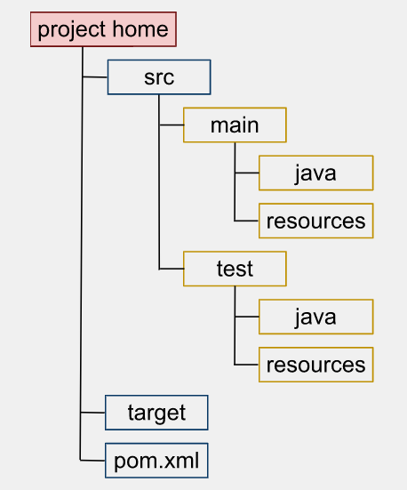
Maven Directory Structure

Slide 35
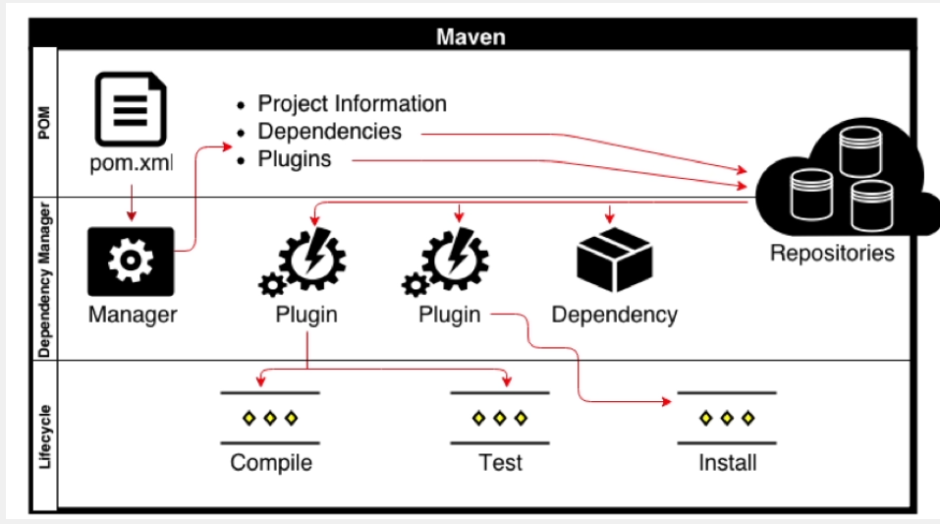
Life cycle bindings - High-level Architecture

Slide 36
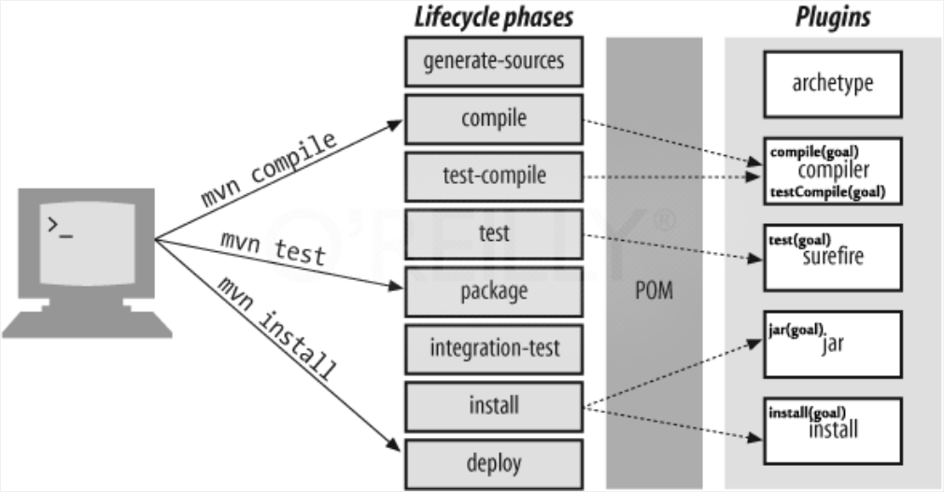
Maven Workflow

Slide 37
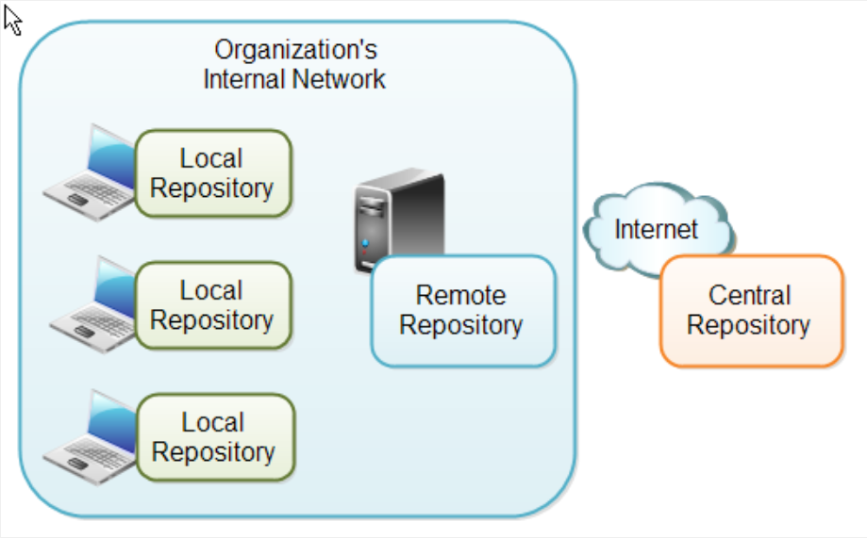
Maven Repositories

Slide 38
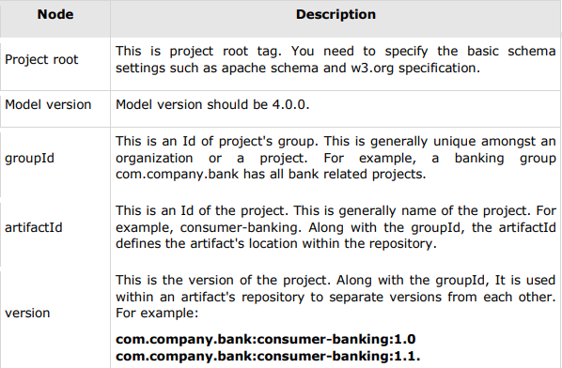
POM Components

Slide 39
Spring

Slide 40
What is a Web Framework?
A web framework is a software framework designed to simplify your web development life.
Frameworks exist to save you from having to re-invent the wheel and help alleviate some of the overhead when building a new site.
Sessions and cookies
Rest
Database
Template engines

Slide 41

Spring Framework
Lead by pivotal
Open source application
Plugins and support for most web technologies
Loads of utility API-s

Slide 42
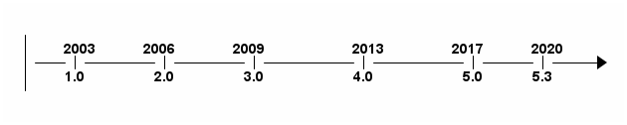
Overview
Spring is the most popular application development framework for enterprise Java. Millions of developers around the world use Spring Framework to create high performing, easily testable, reusable code.

Slide 43
Should I bother?
Free
Easy to use
No XML anymore
Extremely popular
Java, Groovy and Kotlin support
Good for cloud and microservices

Slide 44
Benefits
Spring enables developers to develop enterprise-class applications using POJOs.
Spring is organized in a modular fashion.
Spring does not reinvent the wheel instead, it truly makes use of some of the existing technologies.
Testing an application written with Spring is simple because environment-dependent code is moved into this framework.
Spring's web framework is a well-designed web MVC framework.
Lightweight IoC containers tend to be lightweight, especially when compared to EJB containers.
Spring provides a consistent transaction management.

Slide 45
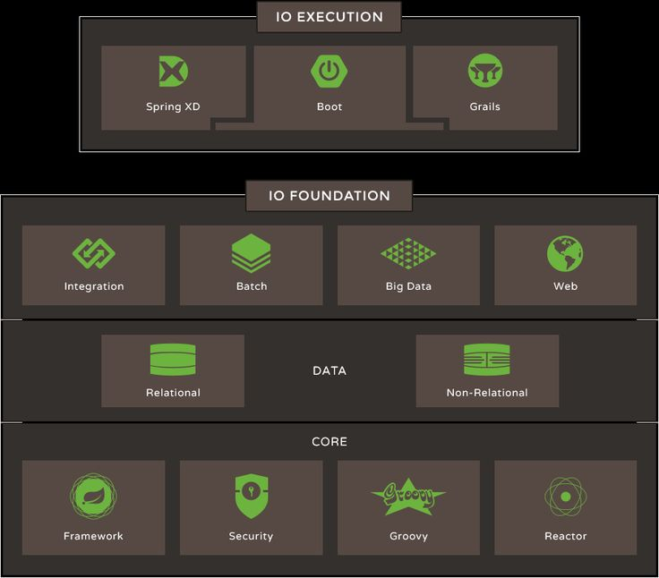
Spring IO Platform

Slide 46
SPRING IO PLATFORM - CORE
Spring Framework | Provides core support for dependency injection, transaction management, web apps, data access, messaging and more.
Spring Security | Protects your application with comprehensive and extensible authentication and authorization support.
Groovy | Brings high-productivity dynamic language features to the JVM.
Reactor | A foundation for reactive fast data applications on the JVM.

Slide 47
SPRING IO PLATFORM - DATA
Spring IO addresses modern data landscape — whether it be document, graph, key-value, relational, or simply unstructured files.

Slide 48
SPRING IO PLATFORM - WORKLOADS
Integration | Channels, Adapters, Filters, Transformers
Batch | Jobs, Steps, Readers, Writers
Big data | Ingestion, Export, Orchestration, Hadoop
Web | Controllers, REST, WebSocket

Slide 49
SPRING FRAMEWORK
Spring is the most popular application development framework for enterprise Java.
The core features of the Spring Framework can be used in developing any Java application, but there are extensions for building web applications on top of the Java EE platform.
Spring enables you to build applications from “plain old Java objects” (POJOs) and to apply enterprise services non-invasively to POJOs. This capability applies to the Java SE programming model and to full and partial Java EE.

Slide 50
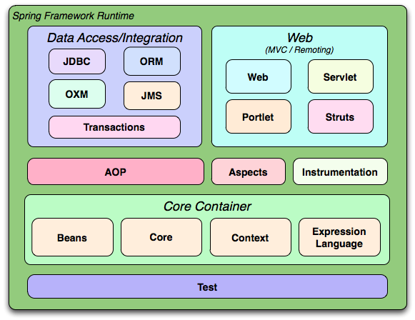
SPRING FRAMEWORK - COMPONENTS

Slide 51
SPRING FRAMEWORK - CORE CONTAINER
The Core module provides the fundamental parts of the framework, including the IoC and Dependency Injection features.
The Bean module provides BeanFactory which is a sophisticated implementation of the factory pattern.
The Context module builds on the solid base provided by the Core and Beans modules and it is a medium to access any objects defined and configured.
The Expression Language module provides a powerful expression language for querying and manipulating an object graph at runtime.

Slide 52
SPRING FRAMEWORK - DATA ACCESS
The JDBC module provides a JDBC-abstraction layer that removes the need to do tedious JDBC related coding.
The ORM module provides integration layers for popular object-relational mapping APIs, including JPA, JDO, Hibernate, and iBatis.
The OXM module provides an abstraction layer that supports Object/XML mapping implementations for JAXB, Castor, XMLBeans, JiBX and XStream.
The Java Messaging Service JMS module contains features for producing and consuming messages.
The Transaction module supports programmatic and declarative transaction management for classes that implement special interfaces and for all your POJOs.

Slide 53
SPRING FRAMEWORK - WEB
Spring's Web module provides basic web-oriented integration features such as multipart file-upload functionality and the initialization of the IoC container using servlet listeners and a web-oriented application context.
The Web-Servlet module contains Spring's model-view-controller (MVC) implementation for web applications. Spring's MVC framework provides a clean separation between domain model code and web forms, and integrates with all the other features of the Spring Framework.
The Web-Portlet module provides the MVC implementation to be used in a portlet environment and mirrors the functionality of Web-Servlet module.
The Web-Struts module contains the support classes for integrating a classic Struts web tier within a Spring application.

Slide 54
SPRING FRAMEWORK - AOP
Spring' AOP module provides an AOP Alliance-compliant aspect-oriented programming implementation allowing you to define, for example, method-interceptors and pointcuts to cleanly decouple code that implements functionality that should be separated.
The separate Aspects module provides integration with AspectJ.
The Instrumentation module provides class instrumentation support and classloader implementations to be used in certain application servers.

Slide 55
INVERSION OF CONTROL
Inversion of control (IoC) is a programming technique in which object coupling is bound at run time by an assembler object and is typically not known at compile time using static analysis. In order for the assembler to bind objects to one another, the objects must possess compatible abstractions.
is a concept in application development
"don’t call me, I’ll call you"
one form is Dependency Injection (DI

Slide 56
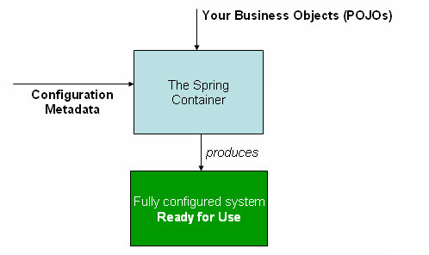
INVERSION OF CONTROL

Slide 57
INVERSION OF CONTROL
The Spring container is at the core of the Spring Framework.
The Spring container uses dependency injection (DI) to manage the components that make up an application.
The container will create the objects, wire them together, configure them, and manage their complete lifecycle from creation till destruction.
The container gets its instructions on what objects to instantiate, configure, and assemble by reading configuration metadata provided. The configuration metadata can be represented either by XML, Java annotations, or Java code.

Slide 58
DEPENDENCY INJECTION CONTAINERS
Spring BeanFactory Container
This is the simplest container providing basic support for DI. There are a number of implementations of the BeanFactory interface that come supplied straight out-of-the-box with Spring. The most commonly used BeanFactory implementation is the XmlBeanFactory class.
Spring ApplicationContext Container
The ApplicationContext includes all functionality of the BeanFactory, it is generally recommended over the BeanFactory. It adds more enterprise-specific functionality such as the ability to resolve textual messages from a properties file and the ability to publish application events to interested event listeners.

Slide 59
BEANS
The objects that form the backbone of your application and that are managed by the Spring IoC container are called beans.
A bean is an object that is instantiated, assembled, and otherwise managed by a Spring IoC container. These beans are created with the configuration metadata that you supply to the container, for example, in the form of XML <bean/> definitions which you have already seen in previous chapters.

Slide 60
BEANS - DEFINITION
The bean definition contains the information called configuration metadata which is needed for the container to know the followings:
How to create a bean
Bean's lifecycle details
Bean's dependencies

Slide 61
BEANS - DEFINITION
Property | Description
class* | The bean class to be used to create the bean.
name | The unique bean identifier.
scope | The scope of the objects created from a particular bean definition.
autowiring mode | Used to specify autowire mode for a bean definition
lazy-initialization mode | Tells the IoC container to create a bean instance when it is first requested, rather than at startup.
constructor-arg | Used to inject the dependencies into the class through a class constructor
properties | Used to inject the dependencies into the class through setter methods

Slide 62
BEANS - DEFINITION
Property | Description
initialization method | A callback to be called just after all necessary properties on the bean have been set by the container.
destruction method | A callback to be used when the container containing the bean is destroyed.

Slide 63
BEANS - SCOPES
Scope | Description
singleton | This scopes the bean definition to a single instance per Spring IoC container (default).
prototype | This scopes a single bean definition to have any number of object instances.
request * | This scopes a bean definition to an HTTP request.
session * | This scopes a bean definition to an HTTP session.
global-session * | This scopes a bean definition to a global HTTP sessions

Slide 64
BEANS - DEFINITION INHERITANCE
Spring Bean definition inheritance has nothing to do with Java class inheritance.
You can define a parent bean definition as a template and other child beans can inherit required configuration from the parent bean.
A child bean definition inherits configuration data from a parent definition. The child definition can override some values, or add others, as needed.
When you use XML-based configuration metadata, you indicate a child bean definition by using the parent attribute, specifying the parent bean as the value of this attribute.

Slide 65
BEANS - LIFECYCLE
The life cycle of a Spring bean is easy to understand.
When a bean is instantiated, it may be required to perform some initialization to get it into a usable state.
When the bean is no longer required and is removed from the container, some cleanup may be required.

Slide 66
BEANS - LIFECYCLE - INITIALIZATION
The org.springframework.beans.factory.InitializingBean interface specifies a single method:
In the XML-based configuration metadata, you can use the init-method attribute to specify the name of the method that has a void no-argument signature.
Annotate the method with @PostConstruct
void afterPropertiesSet() throws Exception
<bean id=“..” class=“..” init-method=“init”/>
@PostConstruct
public void init(){
….
}

Slide 67
BEANS - LIFECYCLE - DESTRUCTION
The org.springframework.beans.factory.DisposableBean interface specifies a single method:
In the XML-based configuration metadata, you can use the init-method attribute to specify the name of the method that has a void no-argument signature.
Annotate the method with @PostConstruct
void destroy() throws Exception
<bean id=“..” class=“..” destroy-method=“destroy”/>
@PreDestroy
public void destroy(){
….
}

Slide 68
BEANS - MULTIPLE LIFECYCLE MECHANISMS
Multiple lifecycle mechanisms configured for the same bean are called in the following order:
Initialization:
Methods annotated with @PostConstruct
afterPropertiesSet() as defined by the InitializingBean callback interface
A custom configured init() method
Destruction:
Methods annotated with @PreDestroy
destroy() as defined by the DisposableBean callback interface
A custom configured destroy() method

Slide 69
DEPENDENCY INJECTION & AUTOWIRING
When writing a complex Java application, application classes should be as independent as possible of other Java classes to increase the possibility to reuse these classes and to test them independently of other classes while doing unit testing.
Dependency Injection (or sometime called wiring) helps in gluing these classes together and same time keeping them independent.

Slide 70
DEPENDENCY INJECTION TYPES
Type | Description
Constructor-based | Constructor-based DI is accomplished when the container invokes a class constructor with a number of arguments, each representing a dependency on other class.
Setter-based | Setter-based DI is accomplished by the container calling setter methods on your beans after invoking a no-argument constructor or no-argument static factory method to instantiate your bean.

Slide 71
CONSTRUCTOR-BASED DEPENDENCY INJECTION
Constructor-based DI is accomplished when the container invokes a class constructor with a number of arguments, each representing a dependency on other class.

Slide 72
SETTER-BASED DEPENDENCY INJECTION
Setter-based DI is accomplished by the container calling setter methods on your beans after invoking a no-argument constructor or no-argument static factory method to instantiate your bean.

Slide 73
AUTOWIRING MODE
Scope | Description
no | No autowiring. You should use explicit bean reference for wiring.
byName | Autowiring by property name. Spring container looks at the properties of the beans on which autowire attribute is set to byName in the XML configuration file.
byType | Autowiring by property datatype. Spring container looks at the properties of the beans on which autowire attribute is set to byType in the XML configuration file.
constructor | Similar to byType, but type applies to constructor arguments.
autodetect | Spring first tries to wire using autowire by constructor, if it does not work, Spring tries to autowire by byType.

Slide 74
ANNOTATION BASED CONFIGURATION
Starting from Spring 2.5 it became possible to configure the dependency injection using annotations. So instead of using XML to describe a bean wiring, you can move the bean configuration into the component class itself by using annotations on the relevant class, method, or field declaration.
Annotation injection is performed before XML injection, thus the latter configuration will override the former for properties wired through both approaches.

Slide 75
ANNOTATION BASED CONFIGURATION
Annotation wiring is not turned on in the Spring container by default. So, before we can use annotation-based wiring, we will need to enable it in our Spring configuration file. So consider to have following configuration file in case you want to use any annotation in your Spring application.

Slide 76
ANNOTATION BASED CONFIGURATION
@Autowired | The @Autowired annotation can apply to bean property setter methods, non-setter methods, constructor and properties.
@Qualifier | The @Qualifier annotation along with @Autowired can be used to remove the confusion by specifiying which exact bean will be wired.
@Required | The @Required annotation applies to bean property setter methods.
JSR-250 Annotations | Spring supports JSR-250 based annotations which include @Resource, @PostConstruct and @PreDestroy annotations.

Slide 77
JAVA BASED CONFIGURATION
Java based configuration option enables you to write most of your Spring configuration without XML but with the help of few Java-based annotations explained below..
Annotating a class with the @Configuration indicates that the class can be used by the Spring IoC container as a source of bean definitions.
The @Bean annotation tells Spring that a method annotated with @Bean will return an object that should be registered as a bean in the Spring application context.

Slide 78
SPRING WEB MVC FRAMEWORK
The Spring web MVC framework provides model-view-controller architecture and ready components that can be used to develop flexible and loosely coupled web applications.
The MVC pattern results in separating the different aspects of the application (input logic, business logic, and UI logic), while providing a loose coupling between these elements.

Slide 79
SPRING WEB MVC FRAMEWORK
The Model encapsulates the application data and in general they will consist of POJO.
The View is responsible for rendering the model data and in general it generates HTML output that the client's browser can interpret.
The Controller is responsible for processing user requests and building appropriate model and passes it to the view for rendering.

Slide 80
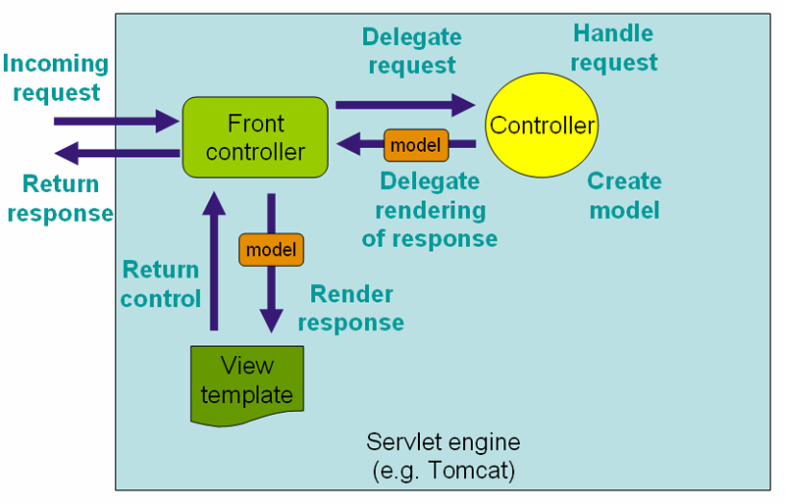
SPRING WEB MVC FRAMEWORK

Slide 81
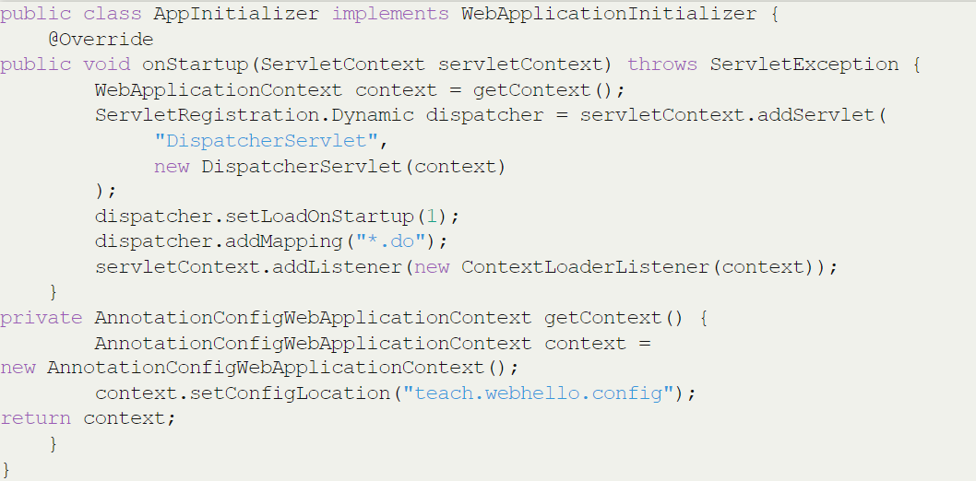
BASIC CONFIGURATION
AppInitializer.java

Slide 82
BASIC CONFIGURATION
AppConfig.java
WebConfig.java
@Configuration
@ComponentScan("teach.webhello.config") public class AppConfig { }
@Configuration @EnableWebMvc @ComponentScan("teach.webhello.controller") public class WebConfig extends WebMvcConfigurerAdapter { @Bean public ViewResolver viewResolver() { InternalResourceViewResolver resolver = new InternalResourceViewResolver(); resolver.setPrefix("/WEB-INF/views/"); resolver.setSuffix(".jsp"); return resolver; } }

Slide 83
CONTROLLERS
DispatcherServlet delegates the request to the controllers to execute the functionality specific to it.
The @Controller annotation indicates that a particular class serves the role of a controller.
The @RequestMapping annotation is used to map a URL to either an entire class or a particular handler method.
The class-level usage of @RequestMapping indicates that all handling methods on this controller are relative to his path.

Slide 84
CONTROLLERS
HelloController.java
@Controller public class HelloController
{ @RequestMapping("/index") public String hello(ModelMap model)
{ model.addAttribute("date", new Date()); return "hello"; } }

Slide 85
VIEWS
Spring MVC supports many types of views for different presentation technologies. These include - HTML, PDF, Excel, XML, Velocity, JSON, Atom/RSS feeds, JasperReports etc. But most commonly we use JSP templates written with JSTL.
hello.jsp:
<html> <head> <title>Home page</title> </head> <body> <h1>${message}</h1> <p>Today is: ${date}</p> </body> </html>

Slide 86
@REQUESTMAPPING DETAILS
URI templates can be used for convenient access to selected parts of a URL in a @RequestMapping method.
A URI Template is a URI-like string, containing one or more variable names. When you substitute values for these variables, the template becomes a URI.
For example, the URI
Template http://www.example.com/users/{userId} contains the variable userId.
Assigning the value fred to the variable yields http://www.example.com/users/fred.

Slide 87
@REQUESTMAPPING DETAILS
@RequestMapping(value = "/users/{userId}", method = RequestMethod.GET)
public String findUser(@PathVariable String userId, Model model)
{
User user = userService.findById(userId);
model.addAttribute("user", user);
return "displayUser";
}
@Controller @RequestMapping(value = "/users/{userId}") public class UsersController
{ @RequestMapping(value = "/docs/{docId}", method = RequestMethod.GET)
public String findDoc(@PathVariable String userId, @PathVariable String docId, Model model) { ... } }

Slide 88
Before we Start
Develop a web application which reads Employee information from MySQL DB and print on the screen . You need to use Spring and Hibernate(JPA). It Should be run in any web container.

Slide 89

Spring Boot With Microservices

Slide 90
Why Spring Boot
Provides a radically faster and widely accessible ‘getting started’ experience for all Spring development
No clumsy XML Configuration by developers
Provide opinionated ‘starter’ POMs to simplify your Maven configuration
Uses project management tool such as MAVEN or GRADLE
Helps fast development and production ready code
Embed Tomcat, Jetty or Undertow directly (no need to deploy WAR files)
In memory DB

Slide 91
Documentation
http://docs.spring.io/spring-boot/docs/current/reference/html/index.html

Slide 92
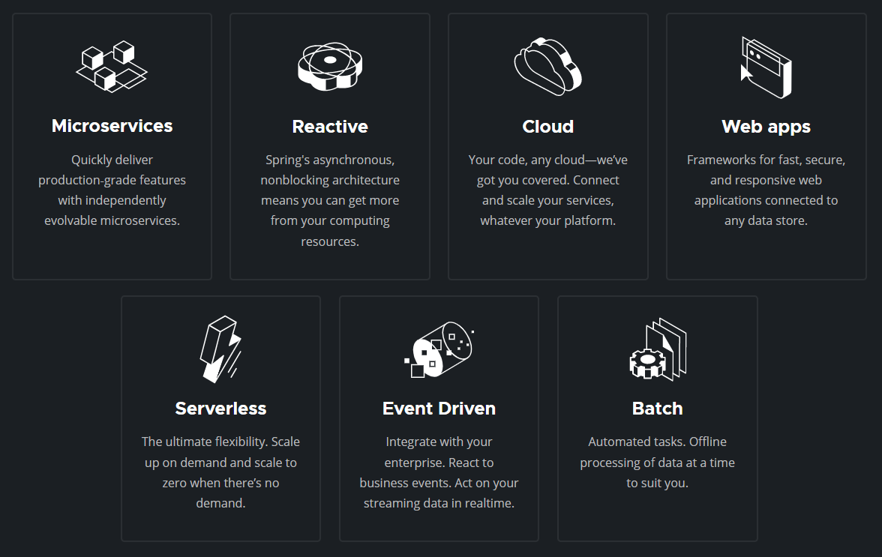
What can Spring do?

Slide 93

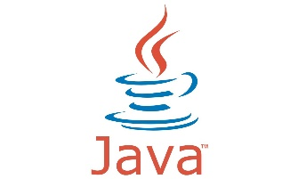
System Requirement
Current Stable Version is Spring Boot 2.6.6
Apache Maven
Java 8 (or Higher Version) +

Slide 94
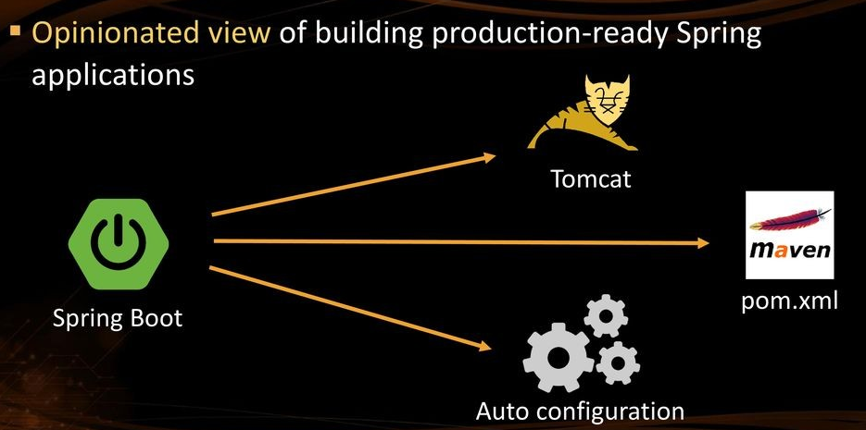
Spring Boot

Slide 95
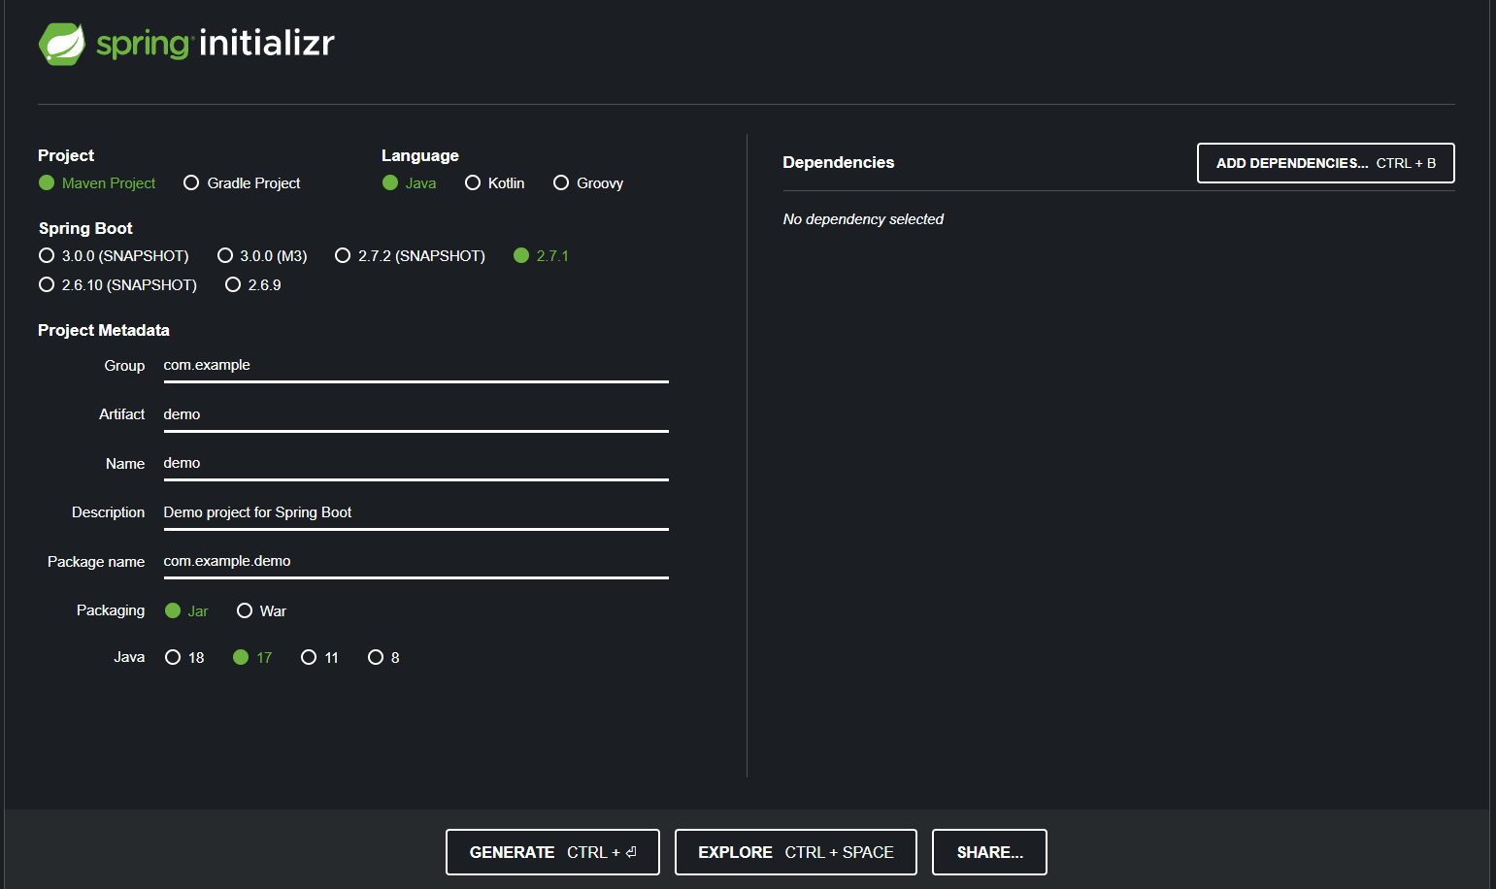
http://start.spring.io – a good starting point

Slide 96
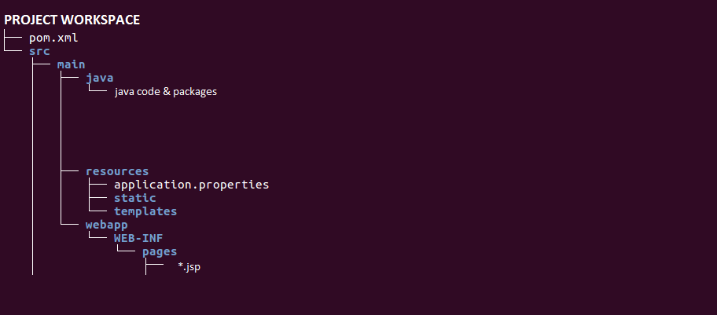
Folder Structure to be followed

Slide 97
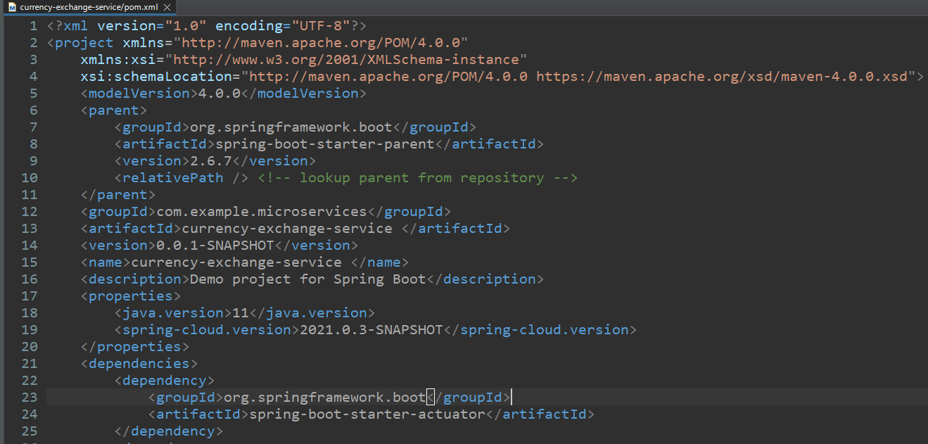
Understanding pom.xml

Slide 98
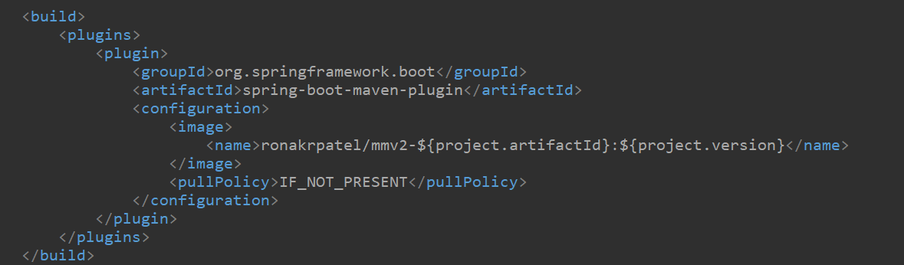
Build runnable jar

Slide 99
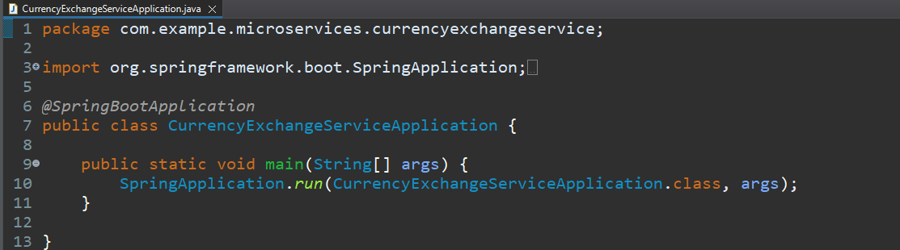
First Java Program for spring boot

Slide 100
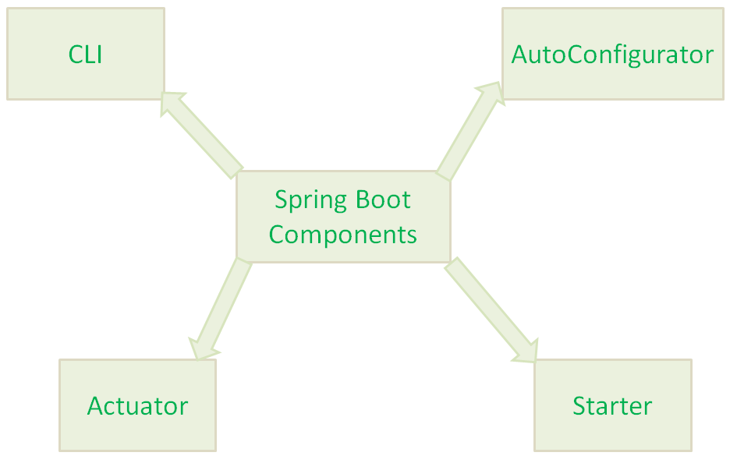
Spring Boot Main Components
Spring Boot Starters
Spring Boot AutoConfigurator
Spring Boot CLI
Spring Boot Actuator

Slide 101
Spring Boot Starter
The main responsibility of Spring Boot Starter is to combine a group of common or related dependencies into single dependencies.
Advantages
reduces defining many dependencies simplify project build dependencies
simplifies project build dependencies.

Slide 102
Spring Boot AutoConfigurator
To develop a Spring-based application requires lot of configuration (Either XML Configuration of Annotation Configuration)
The main responsibility of Spring Boot AutoConfigurator is to reduce the Spring Configuration.
Spring Boot AutoConfigurator component will take care of providing those information.
Spring Boot reduces defining of Annotation configuration.
If we use @SpringBootApplication annotation at class level, then Spring Boot AutoConfigurator will automatically add all required annotations to Java Class ByteCode.

Slide 103
Spring Boot CLI
Spring Boot CLI(Command Line Interface) is a Spring Boot software to run and test Spring Boot applications from command prompt.
When we run Spring Boot applications using CLI, then it internally uses Spring Boot Starter and Spring Boot AutoConfigurate components to resolve all dependencies and execute the application.
spring run HelloWorld.groovy

Slide 104
Spring Boot Actuator
Providing Management EndPoints to Spring Boot Applications.
Spring Boot Applications Metrics.
When we run our Spring Boot Web Application using CLI, Spring Boot Actuator automatically provides hostname as “localhost” and default port number as “8080”. We can access this application using “https://localhost:8080/” end point.
We actually use HTTP Request methods like GET and POST to represent Management EndPoints using Spring Boot Actuator.

Slide 105
REST Essentials

Slide 106
RESTful web Services
REST stands for REpresentational State Transfer.
It is developed by Roy Thomas Fielding, who also developed HTTP.
The main goal of RESTful web services is to make web services more effective.
REST is an architectural approach, not a protocol.
We can build REST services with both XML and JSON.
JSON is more popular format with REST.
https://en.wikipedia.org/wiki/Representational_state_transfer

Slide 107
HTTP Methods
GET: It reads a resource.
PUT: It updates an existing resource.
POST: It creates a new resource.
DELETE: It deletes the resource.

Slide 108
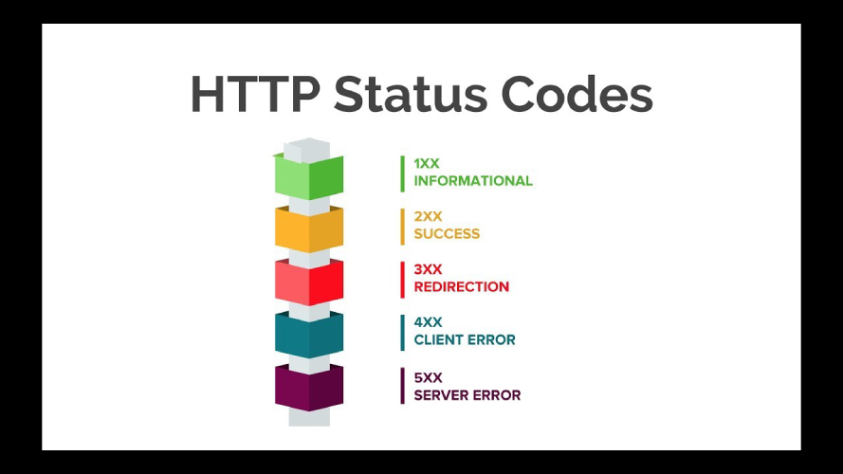

Slide 109
Important - Status Code
404: RESOURCE NOT FOUND
200: SUCCESS
201: CREATED
401: UNAUTHORIZED
500: SERVER ERROR

Slide 110
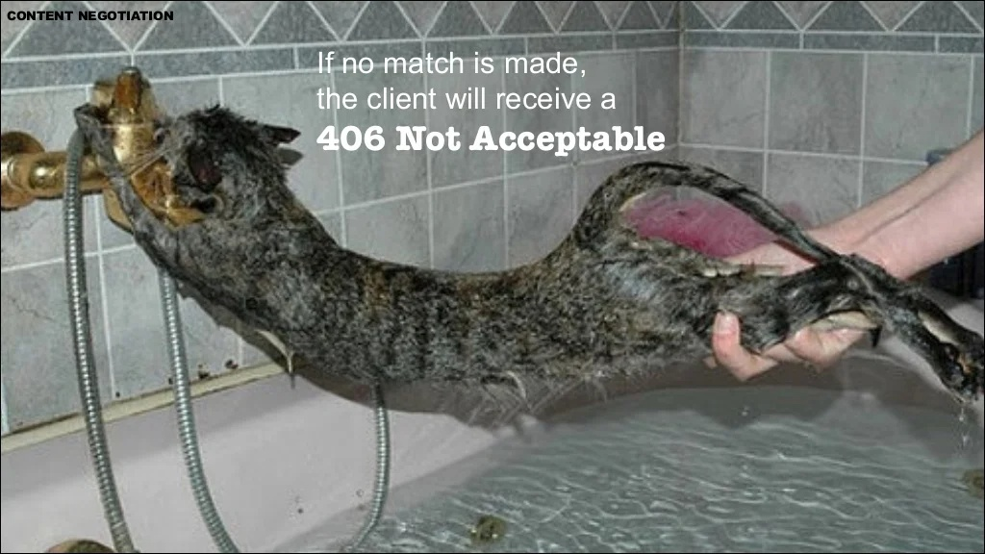

Slide 111
Examples
POST /users: It creates a user.
GET /users/{id}: It retrieves the detail of a user.
GET /users: It retrieves the detail of all users.
DELETE /users: It deletes all users.
DELETE /users/{id}: It deletes a user.
GET /users/{id}/posts/post_id: It retrieve the detail of a specific post.
POST / users/{id}/ posts: It creates a post of the user.

Slide 112
RESTful Service Constraints
There must be a service producer and service consumer.
The service is stateless.
The service result must be cacheable.
The interface is uniform and exposing resources.
The service should assume a layered architecture.

Slide 113
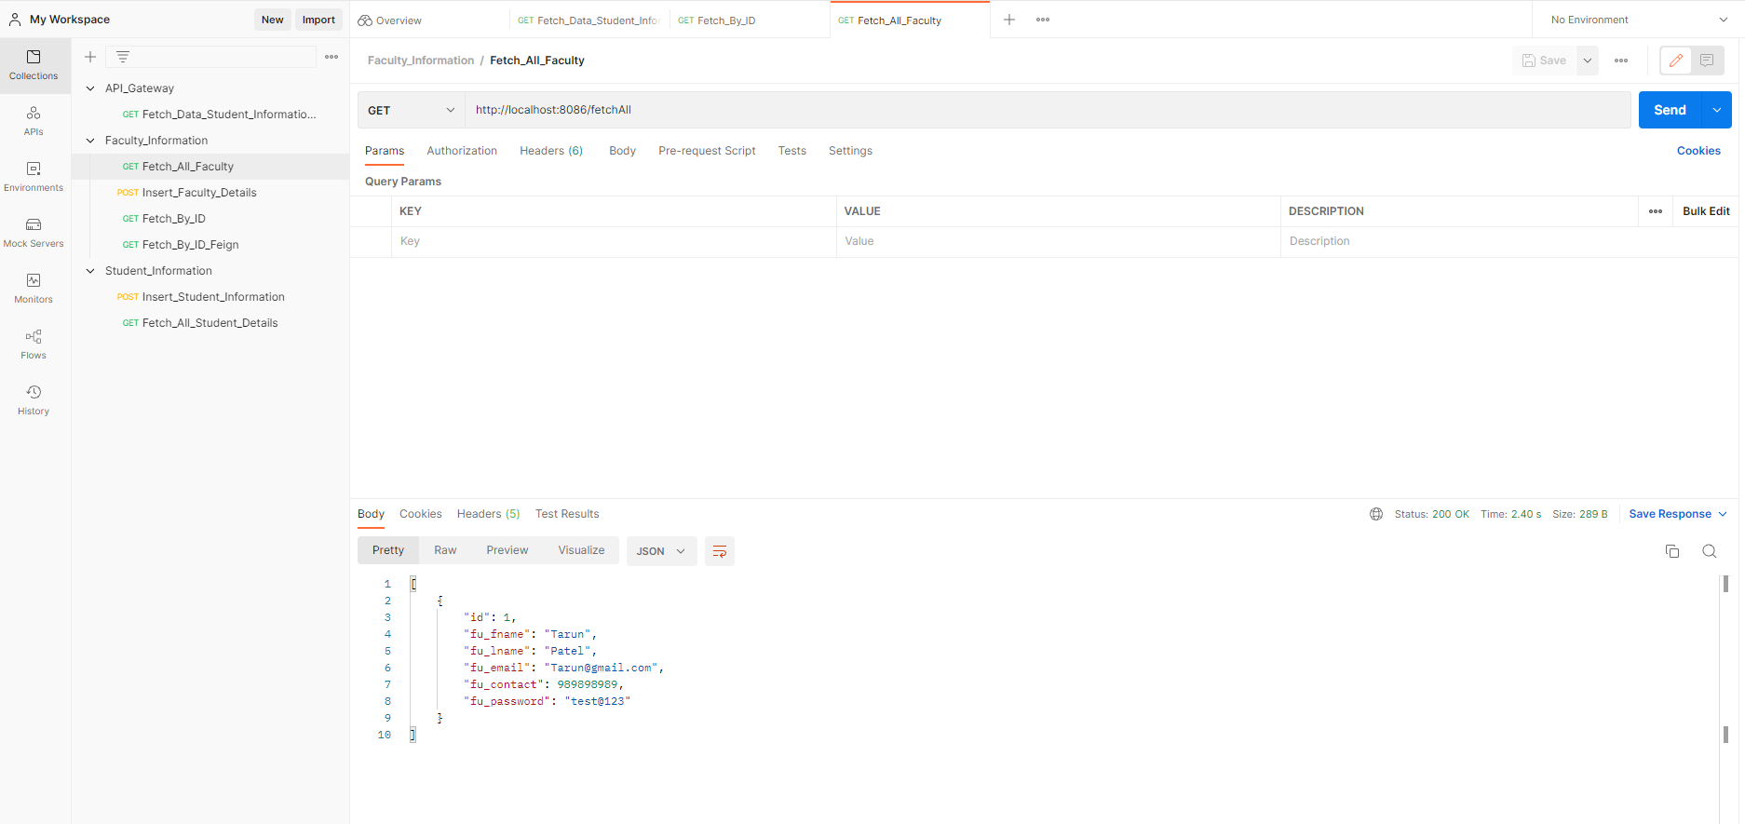
GET API
Status Code
JSON Data

Slide 114
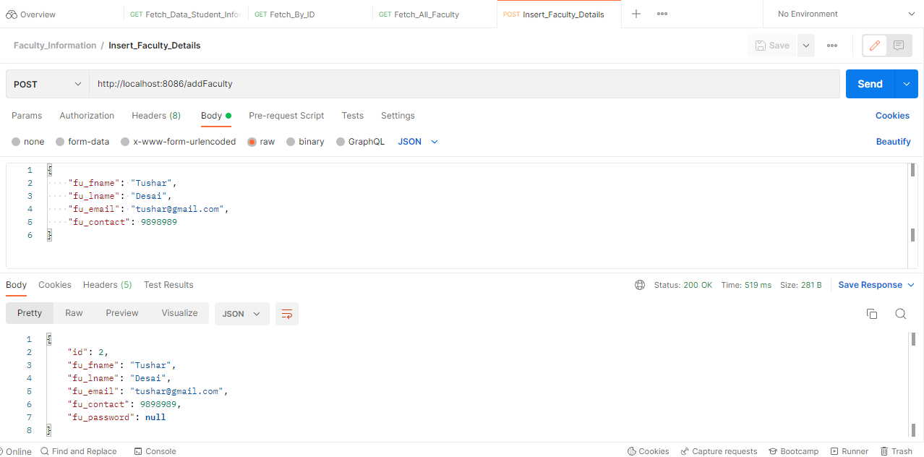

Slide 115
Spring Boot On AWS
Deployment Spring Boot application
AWS EC2
AWS Elastic Beanstalk

Slide 116
Spring Boot with AWS EC2
First Create EC2 instance
Second Deployed Your application

Slide 117
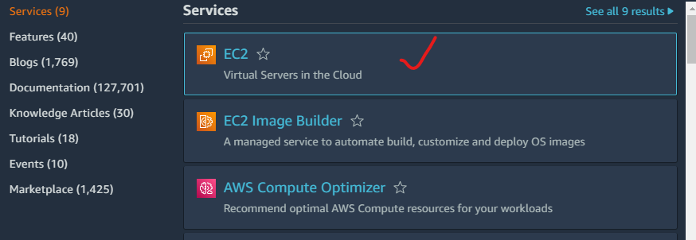
Create EC2 instance

Slide 118
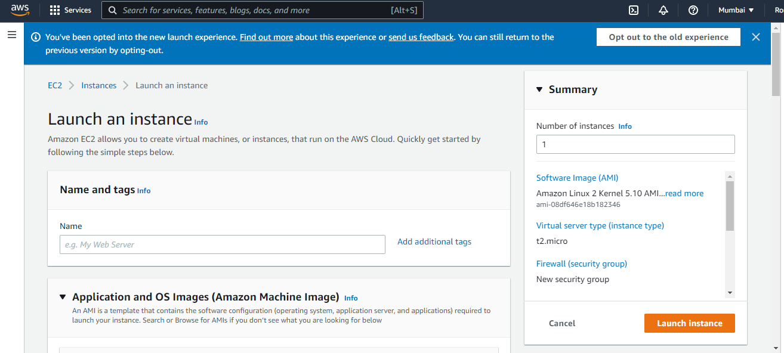
Launch Instance
Click this one

Slide 119
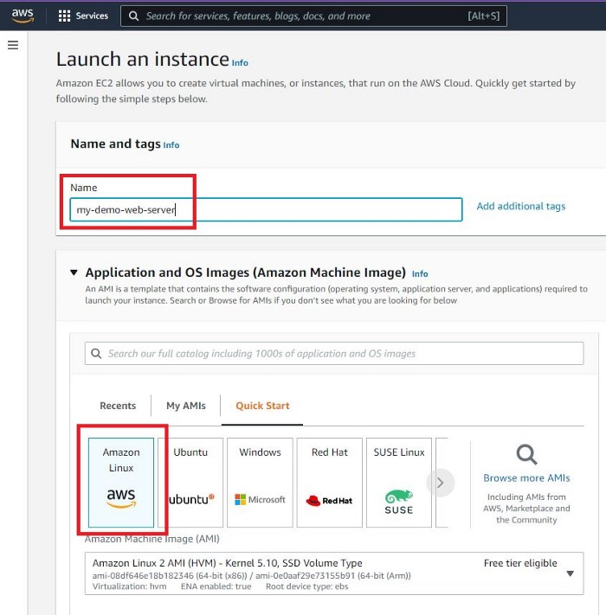
Give Name of Instance & Take OS Image

Slide 120
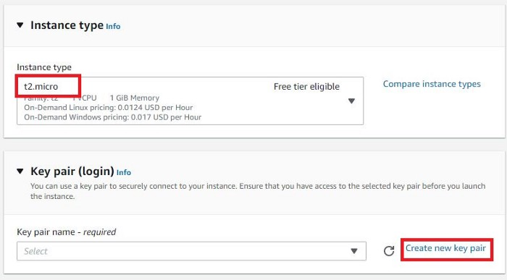
Instance Type + Key Pair

Slide 121
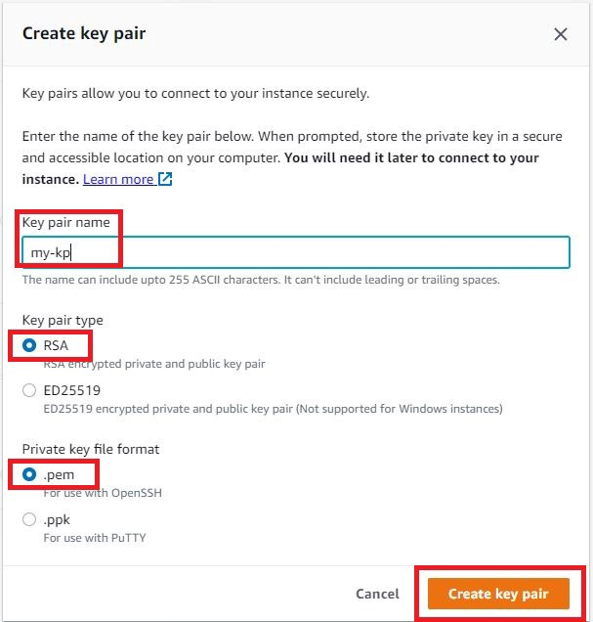
Key Pair

Slide 122
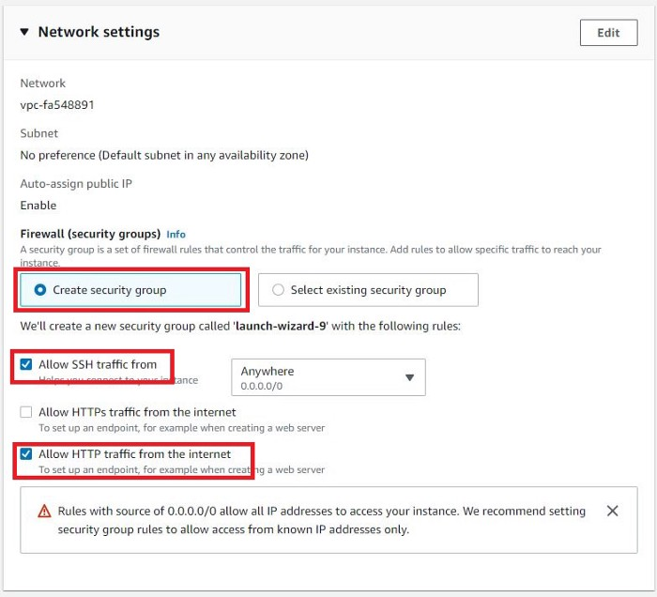
Network Settings

Slide 123
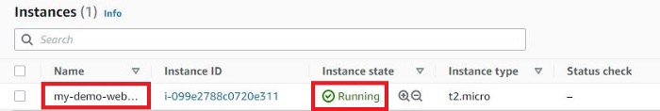
Check Instance Status

Slide 124
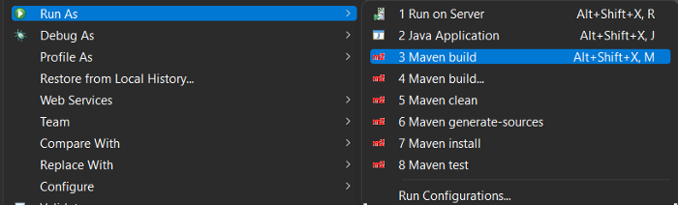
Spring Boot Application
Create a WAR file of your Spring Boot Project
<packaging>war</packaging>
run the app as Maven build

Slide 125
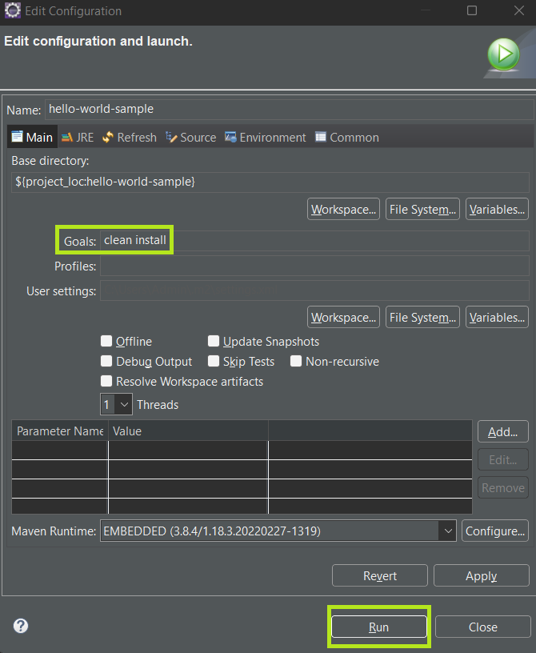
Edit Configuration

Slide 126
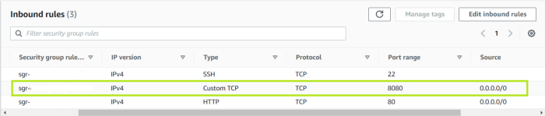
Make Sure EC2 Instance Run on 8080 Port

Slide 127
Install Java and Tomcat server on EC2
First, update the instance:
sudo yum update –y
Install Java 8:
yum install java-1.8.0-openjdk
Verify Java Version
java –version

Slide 128
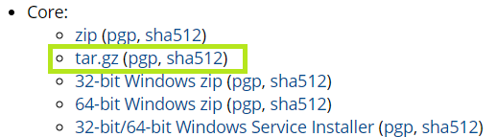
Install Apache Tomcat
Use this link for download
https://tomcat.apache.org/download-90.cgi

Slide 129
Apply Certain Command to install tomcat
wget https://dlcdn.apache.org/tomcat/tomcat-9/v9.0.64/bin/apache-tomcat-9.0.64.tar.gz
Highlighted one is the link of the tar file.
Now Start Tomcat Server
cd apache-tomcat-9.0.64/ cd bin/
Start Command
./startup.sh
Check with the Ec2 Ip Address with 8080 Port Number
Example : 12.34.56.78:8080

Slide 130
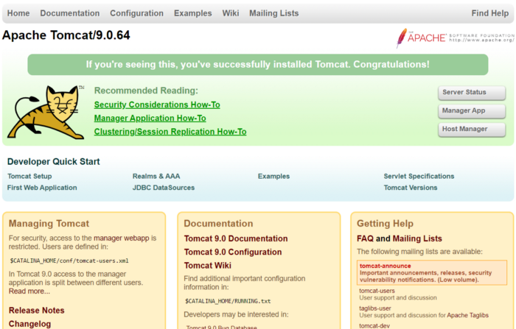
Tomcat Screen Open

Slide 131
Permission to the User
open tomcat-users.xml
For that
cd conf
vi tomcat-users.xml
Update the Code
<user username="your-username" password="your-password" roles="manager-gui"/>
Replace the red coloured connect by your content because it’s used to mage the application when you make applied.

Slide 132
Remove default localhost URL
Go to
webapps/manager/META-INF
We have to launch our application on EC2 server so remove this line
<Valve className="org.apache.catalina.valves.RemoteAddValve" allow="127\.\d+\.\d+|::1|0:0:0:0:0:0:0:1"/>
Then ShutDown the Tomcat Server and Restrat it with this command
cd bin
./shutdown.sh
./startup.sh

Slide 133
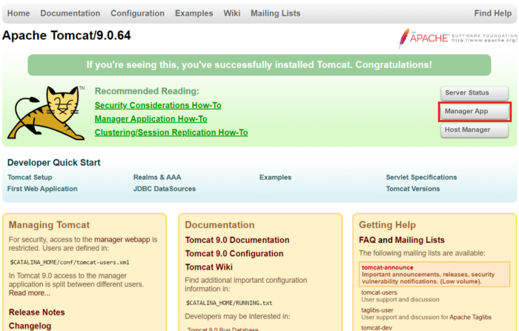
Select the WAR file

Slide 134
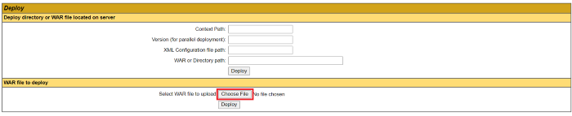
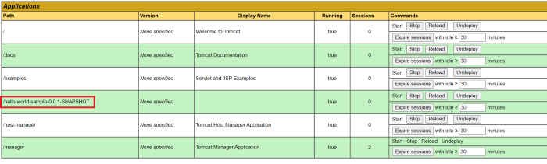
Deployed Application
Check WAR load Properly or not

Slide 135
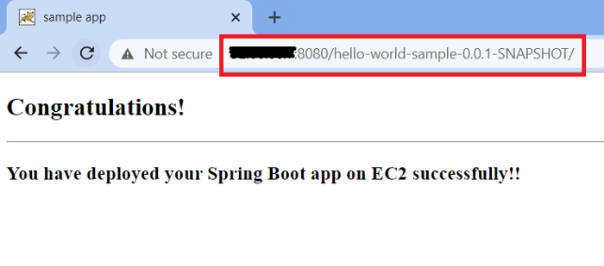
Check on URL

Slide 136
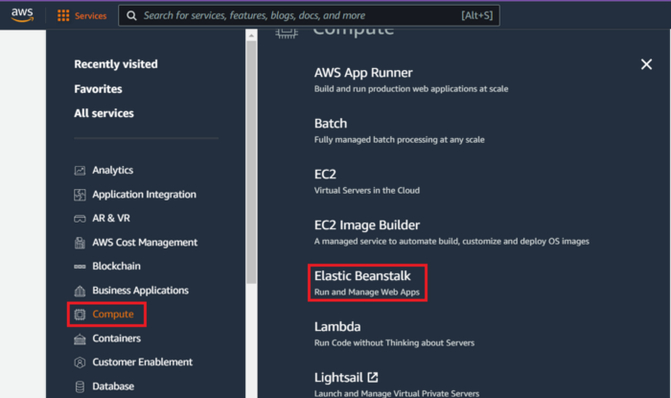
AWS Elastic Beanstalk
Create Application WAR File as we Define in Previous Slides

Slide 137
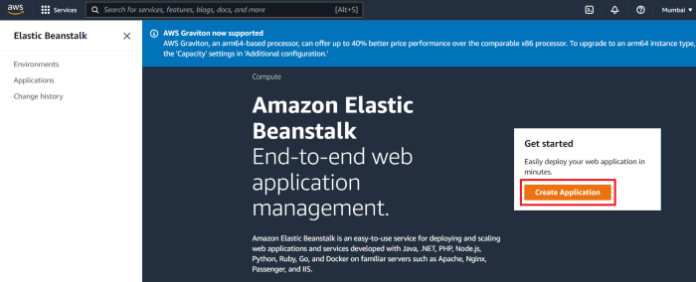
CREATE APPLICATION

Slide 138
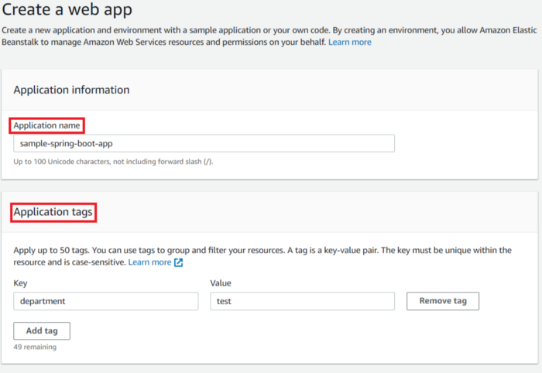
Create Web App

Slide 139
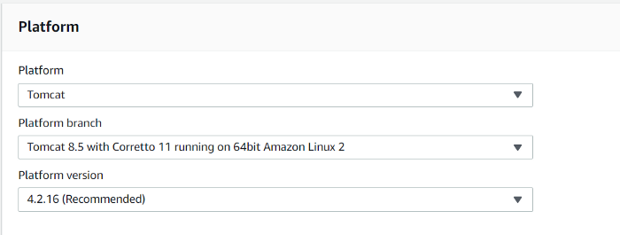
Identify Platform

Slide 140
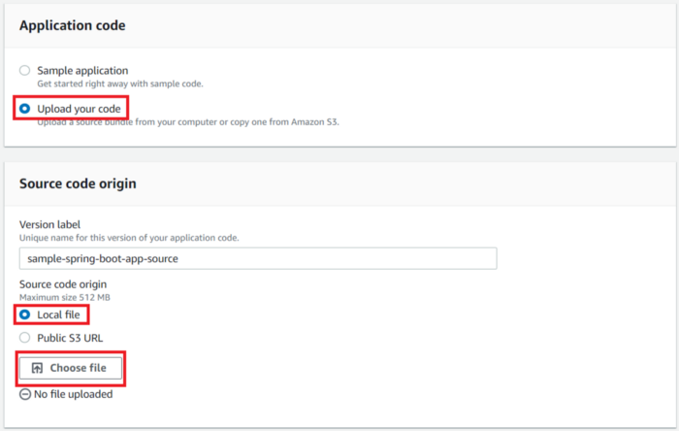
Upload Code

Slide 141
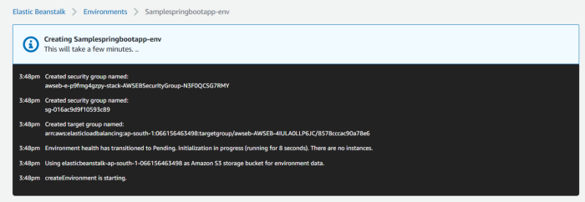
Environment Setup

Slide 142
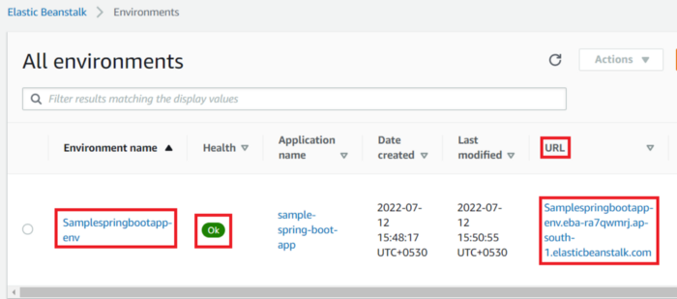
Once Application load Then…

Slide 143
Microservices
Notes:
Hello everyone. Today I’m going to talk about microservices

Slide 144
Contents
What is Microservice
Why should we use Microservice
Where should we use Microservice
When should we use Microservice
How to use Microservice
Discussion
Notes:
In this seminar, I’m going to talk about these things:

Slide 145

What is Microservice
Microservice architecture split Business Logic and Data Access Layer into several small part called Microservices.
Real business logic and Data access are implemented by invoking multiple different microservices distributed on different nodes.
Notes:
So, what is microservice?
Microservice is a kind of software architecture. To understand it, we need to see the traditional Monolithic Architecture first.
In Monolithic Architecture, usually all things are developed in one application including UI components, Business Logic, and Data Access Layer. And usually that application is deploied on one server node.
However, microservice architecture split Business Logic and Data Access Layer into several small part called Microservices. Real business logic and Data access are implemented by invoking multiple different microservices distributed on different nodes.

Slide 146


Why should we use Microservice
Scalability —— Distribution
You don’t need to have one very powerful server to run your application. Instead you could use several relatively weaker servers and run different microservices on each of them. The system will have better IO performance since the tasks are distributed and can be done simultaneously.
By combinng microservice with edge computing, you can take advantage of IOT devices like raspberry pi or arduino to provide service locally for users.
Notes:
So, why should we use Microservice?
Comparing to the traditional monolithic architecture, Microservice has much stronger scalability.
First, It really benefit from the distributtion. You don’t need to have one very powerful server to run your application anymore. Instead you could use several relatively weaker servers and run different microservices on each of them.
The system will have better IO performance since the tasks are distributed and can be done simultaneously. And by combinng microservice with edge computing, you can take advantage of IOT devices like raspberry pi or arduino to provide service locally for users.

Slide 147


Why should we use Microservice
Scalability —— Non-uniform Scaling
Monolithic Architecture
Microservice Architecture
The bottleneck may only exist in some part of the application like request handling. It makes no sense to replicate the whole application for just improving request handling performance.
In Microservice architecture, we can do non-uniform scaling by deploying multiple instance of particular service so we can get higher utilization with less server resource.
Notes:
Microservice is also good because of its ability of non-uniform scaling.
For traditional monolithic architecture, if we want to scale the application for whatever reason, we have to scale it as a whole application.
But actually the bottleneck may only exist in some part of the application like request handling. It make no sense to replicate the whole application for just improving request handling performance.
In Microservice architecture, we can do non-uniform scaling by deploying multiple instance of particular service so we can get higher utilization with less server resource.

Slide 148

Why should we use Microservice
Scalability —— Portability
Microservice architecture has very good portability by using container technology like Docker
Notes:
So one question here is, how are we going to better utilize all the devices we have to provide services? It would be a nightmare if we need to deploy application using different environments or even on different CPU architecture like ARM.
Luckily, Microservice architecture has very good portability by using container technology like Docker. Docker is an open platform for developing, shipping, and running applications. Docker enables you to separate your applications from your infrastructure so you can deliver software quickly.

Slide 149


Why should we use Microservice
Traditional Virtual Machines
Containers
Using Docker doesn’t need to waste resource on duplicated Guest operating system. Docker can also run on ARM devices like raspberry pi which is almost impossible to run virtual machines. By using container technology, microservice can have extremely high utilization of all kind of hardware resources.
Notes:
Comparing to the traditional Virtual Machines way to utilize server resource, container technology doesn’t need to waste resource on duplicated Guest operating system. but it still provide isolated environment for different application, so complex software environment will never be a problem anymore. Besides, Docker can also run on ARM devices like raspberry pi which is almost impossible to run virtual machines.
By using container technology, microservice can have extremely high utilization of all kind of hardware resources.

Slide 150



Why should we use Microservice
Scalability —— Elasticity
When there are not so many requests, the server load is low, and it can stop those unnecessary replicas of services and shutting down some servers to save power and reduce the stress of cooling system. When the request increase, the server could automatically deploy new containers to provide service according to the metrics like response time. When the request number increasing speed hit some threshold or if our machine learning model predicted that there will be a heavy load, the system could boot some servers for more resource to deploy microservice. vice versa
Notes:
Another benifit of Microservice is it’s elasticity.
When there are not so many requests, the server load is low and it can stop those unnecessary replicas of services and shutting down some servers to save power and reduce the stress of cooling system.
When the request increase, the server could automatically deploy new containers to provide service according to the metrics like response time.
When the request number increasing speed hit some threshold or if our machine learning model predicted that there will be a heavy load, the system could boot some servers for more resource to deploy microservice.
vice versa
All these scaling can be done automatically, this could help the companies to save a lot of money and help the world to save a lot of power and reduce carbon emission.

Slide 151




Why should we use Microservice
Scalability —— Availability
When updating the application, we don’t have to shutdown the whole application and then deploy the new one.
by using microservice architecture, we just need a little bit of extra resource for the service we are going to update.
Notes:
Because of the scalability, the microservice architecture usually have high availability.
An common case in software engineering is updating the application.
If we use monolithic architecture, we have to shutdown the whole application and then deploy the new one.
Yes we can use a replica of the application to provide all services during the update but that will need double hardware resources.
However, by using microservice architecture, we just need a little bit of extra resource for the service we are going to update. If there are multiple services need to be updated, we can update them one by one and still we only need a little bit of extra resource.
If we use canary release for updating the service, we can even use zero extra resource.

Slide 152


Why should we use Microservice
Scalability —— Robustness
If one server has hardware failure like hardware broken or power cut. other servers could still provide all the services.
Notes:
With all the features I’ve talked about before, the microservice architecture is very robust.
If one server has hardware failure like hardware broken or power cut. other servers could still provide all the services. All the services exist on the failed server could be automatically re-deployed on the rest servers so the total number of service nodes will keep the same and the performance of the whole system will not be affected.

Slide 153


Where should we use Microservice
Do you heavily rely on in-memory state?
monolithic system
microservices system
In monolithic system, you can take advantage of in-memory state like storing session in memory and mapping request according to the session record in almost no-latency using hashmap. But in microservice, because of the distribution, services can not share memory data. All microservice should be designed as stateless functions.
If you heavily rely on in-memory state or can not accept the latency caused by the data sharing in the distributed microservice architecture, you shouldn’t use microservice here.
Notes:
After knowing all these benefit of microservice, we need also know where should we use microservice. In most cases you can always use microservice for the whole system to get a good scalability and performance. But there are two problems you need to be careful with.
First problem we need to consider is: Do you heavily rely on in-memory state?
In monolithic system, you can take advantage of in-memory state like storing session in memory and mapping request according to the session record in almost no-latency using hashmap.
but in microservice, because of the distribution, services can not share memory data. All microservice should be designed as stateless functions. Although different services can share data using middlewares like message queue, there will be some latency.
If you heavily rely on in-memory state or can not accept the latency caused by the data sharing in the distributed microservice architecture, you shouldn’t use microservice here.

Slide 154


Where should we use Microservice
Do you heavily rely on transactions?
monolithic system
microservices system
To implement transaction in a microservice system is very hard comparing to a monolithic system.
Notes:
Another big problem is transaction.
If your business logic is heavily rely on transactions, you may not use microservice here.
To implement transaction in a microservice system is very hard comparing to a monolithic system.

Slide 155

Where should we use Microservice
Two-phase commit (2pc) pattern
Usually, people use a technique called two-phase commit to simulate transaction in microservice architecture. It has a prepare phase and commit phase to ensure the the eventual consistency. It will be more complicated if there is some error and cause a rollback. So If you don’t want to deal with the two phase commit in distributed transaction, you shouldn’t use microservice here. But other parts can still be splited into different microservices.
Notes:
Usually, people use a technique called two-phase commit to simulate transaction in microservice architecture. It has a prepare phase and commit phase to ensure the the eventual consistency. It will be more complicated if there is some error and cause a rollback. So If you don’t want to deal with the two phase commit in distributed transaction, you shouldn’t use microservice here. But other parts can still be splited into different microservices.

Slide 156

When should we use Microservice
Notes:
Here comes the question about when should we use Microservice.
Comparing to the monolithic architecture, the microservice architecture have lower productivity at first. That’s because microservice need a certain amount of management so it can’t start with relatively high productivity.
while monolithic system not quite need those management at the beginning since the system is simple enough so writing it is as simple as writing a simple microservice
When the complexity of the system growth and hit some threshold, the productivity of monolithic system and microservice system will become the same.
After that, because of the decreased coupling of microservices reduces the attenuation of productivity, but the monolithic system’s productivity will drop rapidly when complexity growth. It’s the time to switch to microservice architecture.

Slide 157

How to use Microservice
Programming language
doesn’t matter
You can use any programming language you want as long as you can provide solid API documentation so other services can communicate with it and invoke the service properly.
Notes:
In microservice architecture, programming language usually doesn’t matter. You can use any programming language you want as long as you can provide solid API documentation so other services can communicate with it and invoke the service properly. Here is a microservice architecture example given by microsoft. you can see it uses many different languages like C#, JS, Python, Java,signalR,F#, and golang.

Slide 158

How to use Microservice
In this architecture, Microsoft uses rabbitMQ and AzureService Bus as the eventbus middleware for data/message sharing between all the microservices.
Using message queue can change the business logic from synchronized logic to asynchronized logic and result in a better io performance.
Notes:
Here is a overview of an eshop application using microservice architecture also provided by microsoft. you can pause at here and spend some time looking at the diagram and learn this architecture.
Notice that in this architecture, microsoft uses rabbitMQ and AzureService Bus as the eventbus middleware for data/message sharing between all the microservices.
Using message queue can change the business logic from synchronized logic to asynchronized logic and result in a better io performance.

Slide 159
Discussion
Positive
Very strong scalability
Distribution
Non-uniform Scaling
Portability
Elasticity
Availability
Robustness
Programming language doesn’t matter, easy to find a developer to build microservices
For a complex system, microservice architecture has higher productivity
Easy to learn, even intern developers can also develop functional and bugless microservice with proper unit test.
Agile friendly
Notes:
so here is the discussion part. I think microservice architecture has these following advantages:
As mentioned before, it has very strong scalability, and the developers can choose whatever language they prefer to build microservices.
For a complex system, microservice architecture usually has higher productivity.
And writing a microservice is very easy. I think even intern developers can also develop functional and bugless microservice with proper unit test.
Also, microservice architecture is agile-friendly. it’s very common to use one or two sprint to develop, evaluate, and improve a microservice.

Slide 160
Discussion
Negative
The granularity of a microservice architecture is hard to decide
Microservice need more precise documentation
Microservice need more experienced System Operator
Microservice should be integrated with Continuous Integration (CI) and Continuous Delivery (CD) otherwise it will cost too much human resource in maintenance
Notes:
But also microservice architecture has some disadvantages and we need to treat these problems carefully.
The biggest problem is the granularity of a microservice architecture is hard to decide.
If the granularity is too low, it can not take advantage of the scalability of microservice because it will looks more like a monolithic system.
but if the granularity is too high, there will be too many message exchanges happen in the eventbus and cause a large latency. The dependencies will also become much more complex and make it harder to manage.
Besides, microservice architecture needs more precise and solid documentation otherwise the invoke chain will be unclear and the whole system may be out of control when its complexity grow.
Because of the management is harder than a monolithic system, microservice architecture needs more experienced system operator.
And the microservice should be integrated with continuous integration and continuous delivery to do a lot of jobs automatically otherwise it will cost too much human resource in maintenance.

Slide 161
Solutions to Challenge with Microservice Architecture
Spring Boot
Spring Boot enables building production ready applications quickly and provides non-functional features:
Embedded Server (Easy to Deployment Container)
Metrics (Monitoring)
Health Check ( Monitoring)
Externalized Configuration
Spring Cloud
Spring Cloud provides tools for developers to quickly build some of the common patterns in distributed systems Coordination of distributed systems leads to boiler plate patterns, and using Spring Cloud developers can quickly stand up services and applications that implement those patterns.

Slide 162
Spring Cloud Features
Distributed/versioned configuration
Service registration and discovery
Routing
Service-to-service calls
Load balancing
Circuit Breakers
Global locks
Leadership election and cluster state
Distributed messaging

Slide 163
Important Spring Cloud Module
Dynamic Scale up and down . Using Combination of
Naming Server (Eureka )
Ribbon ( Client Side Load Balancing)
Feign ( Easier REST Client)
Visibility and Monitoring with
Zipkin Distributed Tracing
Netflix API Gateway
Configuration Management with Spring Cloud Configuration Server
Fault Tolerance with Hystrix

Slide 164


Slide 165


Slide 166
Spring Cloud Config 3.1.3
Spring Cloud Config provides server and client-side support for externalized configuration in a distributed system.
With the Config Server you have a central place to manage external properties for applications across all environments.
Features
HTTP, resource-based API for external configuration
Encrypt and decrypt property values (symmetric or asymmetric)
Embeddable easily in a Spring Boot application using @EnableConfiguration Server
Config Client features (for Spring applications):
Bind to the Config Server and initialize Spring Environment with remote property source
Encrypt and decrypt property values (symmetric or asymmetric)
For More details : https://spring.io/projects/spring-cloud-config#overview

Slide 167
Spring Cloud Netflix 3.1.3
Netflix OSS integrations for Spring Boot apps through autoconfiguration and binding to the Spring Environment and other Spring programming model expressions.
With a few simple annotations, you can quickly enable and configure the common patterns inside your application and build large distributed systems with battle-tested Netflix components.
Spring Cloud Netflix features:
Service Discovery: Eureka instances can be registered and clients can discover the instances using Spring-managed beans
Service Discovery: an embedded Eureka server can be created with declarative Java configuration
For More Details : https://spring.io/projects/spring-cloud-netflix#overview

Slide 168
Spring Cloud Sleuth 3.1.3
Spring Cloud Sleuth provides Spring Boot auto-configuration for distributed tracing.
Features
Sleuth configures everything you need to get started. This includes where trace data (spans) are reported to, how many traces to keep (sampling), if remote fields (baggage) are sent, and which libraries are traced.
If spring-cloud-sleuth-zipkin is available then the app will generate and report Zipkin-compatible traces via HTTP. By default it sends them to a Zipkin collector service on localhost (port 9411). Configure the location of the service using spring.zipkin.baseUrl.
For More Details : https://spring.io/projects/spring-cloud-sleuth

Slide 169
Spring Cloud OpenFeign 3.1.3
This project provides OpenFeign integrations for Spring Boot apps through autoconfiguration and binding to the Spring Environment and other Spring programming model idioms.
Features
Declarative REST Client: Feign creates a dynamic implementation of an interface decorated with JAX-RS or Spring MVC annotations
For More details : https://spring.io/projects/spring-cloud-openfeign

Slide 170
Spring Cloud – Tracing Services with Zipkin
Zipkin is an open source project that provides mechanisms for sending, receiving, storing, and visualizing traces.
This allows us to correlate activity between servers and get a much clearer picture of exactly what is happening in our services.
Zipkin service will serve as the store for all our spans. Each span is sent to this service and collected into traces for future identification.

Slide 171
Externalized Configuration
https://docs.spring.io/spring-boot/docs/2.0.6.RELEASE/reference/html/boot-features-external-config.html

Slide 172
Resiliency
“Resiliency is the ability of application to recover from certain types of failures and remain functional.”
will experience failure so how we build our applications to respond to that failure is a critical part of every software developer’s job.

Slide 173

Why client resiliency matters?

Slide 174
What are client-side resiliency patterns?
Client resiliency software patterns are focused on protecting a micro-service client from crashing, does by “failing-fast” hence preventing the cascading problem caused by a slow downstream systems.
Timeout
Retry
Circuit breakers
Fallbacks
Bulkheads

Slide 175


Slide 176
Resilience4j
Resilience4j is a lightweight, easy-to-use fault tolerance library inspired by Netflix Hystrix, but designed for Java 8 and functional programming.
Lightweight, because the library only uses Vavr, which does not have any other external library dependencies.
Resilience4j provides higher-order functions (decorators) to enhance any functional interface, lambda expression or method reference with a Circuit Breaker, Rate Limiter, Retry or Bulkhead.

Slide 177
Spring Cloud Gateway 3.1.3
This project provides a library for building an API Gateway on top of Spring WebFlux.
Spring Cloud Gateway aims to provide a simple, yet effective way to route to APIs and provide cross cutting concerns to them such as: security, monitoring/metrics, and resiliency.
Features
Built on Spring Framework 5, Project Reactor and Spring Boot 2.0
Able to match routes on any request attribute.
Predicates and filters are specific to routes.
Circuit Breaker integration.
Spring Cloud DiscoveryClient integration
Easy to write Predicates and Filters
Request Rate Limiting
Path Rewriting
For More Details : https://spring.io/projects/spring-cloud-gateway

Slide 178
Spring Boot - OAuth2 with JWT
OAuth2
OAuth2 is an authorization framework that enables the application Web Security to access the resources from the client.
To build an OAuth2 application, we need to focus on the Grant Type (Authorization code), Client ID and Client secret.
JWT Token
JWT Token is a JSON Web Token, used to represent the claims secured between two parties.
This information can be verified and trusted because it is digitally signed.
JWTs can be signed using a secret (with the HMAC algorithm) or a public/private key pair using RSA or ECDSA.

Slide 179
Restful Webservices

Slide 180
Web Service Definition
A web service is a set of methods exposed through a web interface.
Accessible through HTTP
Provides internet access to RPC-like calls that define the service
Web service messages are encoded in an XML dialect called Simple Object Access Protocol (SOAP)
Service model assumes services are always available

Slide 181
Benefits of the Web Service Model
Web services use this special architecture because it:
Can be used from any platform.
Uses a standard, well-know channel.
Is routable and will pass through most firewalls.
Uses the same security mechanisms as any web site.

Slide 182
SOAP Messages
A SOAP Message can be one of three types:
Method call
Contains name of method and parameters
Method Response
Return values
Fault Message
SOAP fault message if service throws an exception
Will get standard HTTP message if transport fails.

Slide 183
SOAP Message Structure
SOAP Message
The complete SOAP message
Headers
Protocol binding headers
SOAP Envelope
<Envelope> encloses payload
SOAP Header
<Header> encloses headers
Headers
Individual headers
SOAP Body
<Body> contains SOAP message name
Message Name & Data
XML-encoded SOAP message name & data
Notes:
A SOAP message is an XML document that consists of a mandatory SOAP envelope, an optional SOAP header, and a mandatory SOAP body.
The envelope is the top element of the XML document representing the message.
The header is a generic mechanism for adding features to a SOAP message in a decentralized manner without prior agreement between the communicating parties. SOAP defines a few attributes that can be used to indicate who should deal with a feature and whether it is optional or mandatory. The Body is a container for mandatory information intended for the ultimate recipient of the message.
SOAP defines one element for the body, which is the Fault element used for reporting errors.

Slide 184
XML & Java
Java API for XML Processing (JAXP)
XML and JavaJava API for XML-Based Web Services (JAX-WS)
Java Architecture for XML Binding (JAXB)
Java API for XML Messaging (JAXM)
Java API for XML Registries (JAXR)
Java API for XML-Based RPC (JAX-RPC)
Java 2 Platform, Enterprise Edition (J2EE)

Slide 185
JAXP (Java API for XML Processing)
Java API for XML Processing
Standardized by Sun
Very thin layer on top of SAX ( Simple API for XML) or DOM ( Document Object Model)
Makes application code parser- independent
Our programs should use JAXP, which in turn, calls parser APIs
The main JAXP APIs are defined in the javax.xml.parsers package.

Slide 186

JAXP - Concepts

Slide 187
JAXP: API or Abstraction?
JAXP is an API, but is called as an abstraction layer
Does not provide new means of parsing XML
Does not add to SAX or DOM
Does not give new functionality to Java or XML handling
Makes working with SAX and DOM easier
It is vendor-neutral

Slide 188
JAXP and Parsing
JAXP is not a replacement for SAX, DOM, JDOM etc
Some vendor must supply the implementation of SAX, DOM, etc
JAXP provides APIs to use these implementations
In the early versions of JDK, Sun had supplied a parser called Crimson
Now, Sun provides Apache Xerces
Both are not a part of JAXP API – they are part of JAXP distribution
In JDK, we can locate Xerces implementations in the org.xml.sax and org.w3c.dom packages
Notes:
https://cupdf.com/document/5-xml-parsing.html?page=53

Slide 189
JAX-WS
Java API for XML Web Services (JAX-WS) is a technology for building web services and clients that communicate using XML.
JAX-WS allows developers to write message-oriented as well as Remote Procedure Call-oriented (RPC-oriented) web services.
In JAX-WS, a web service operation invocation is represented by an XML-based protocol, such as SOAP.
The SOAP specification defines the envelope structure, encoding rules, and conventions for representing web service invocations and responses
For more details : https://docs.oracle.com/javaee/6/tutorial/doc/bnayn.html

Slide 190
JAXB
Java Architecture for XML Binding (JAXB) provides a fast and convenient way to bind XML schemas and Java representations, making it easy for Java developers to incorporate XML data and processing functions in Java applications.
JAXB provides methods for unmarshalling (reading) XML instance documents into Java content trees, and then marshalling (writing) Java content trees back into XML instance documents.
JAXB is simple to use compared to SAX/DOM.
JAXB allows non-sequential processing of XML documents. In DOM we need to navigate a tree structure and JAXB doesn’t requires such navigations.
We work with java instances instead of event/elements. JAXB uses memory efficiently than DOM.

